Slide 1
Bank Loan Default: Part 1
Presented By: Kho Guan Guo

Slide 2
Agenda
Background and Problem Statement
How I started and how I ended up with this project
EDA
Feature Engineering
Modelling X 3
Conclusion
Recommendations

Slide 3
Background
Banks run into losses when a customer doesn't pay their loans on time that can run into the MILLIONS every year.
The bank runs the risk of losing potential business if it rejects a loan application and the prediction of default is wrong.

Slide 4
Problem Statement
Using the given dataset, this project aims to achieve 3 things as its Primary objectives.
1. To utilize the information given and quantify feature importance to accurately predict loan defaults.
2. To engineer features to help better predict loan defaults.
3. To act as a stepping stone to develop better models to be deployed, that can address this issue that banks have and reduce monetary loss.

Slide 5
Starting point
Originally started out wanting to make a model to deploy with 2 goals:
For banks to use by keying in customer information and getting prediction which will be used in the assessment of the loan application.
For banks to let customers do their homework online before applying for loans in order to cut operation time. Customers would key in their information and know the probable outcome.

Slide 6
Metrics and Models
I will be using Accuracy, F1 and Log Loss scores in order to evaluate the models in this project.
Models used: Multinomial Naïve Bayes, Logistic Regression, Random Forest Classifier and XGBoost.

Slide 7
EDA
35 features including the target column
8 categorical
26 continuous
Imbalanced dataset with a 1:10 ratio in target column

Slide 8
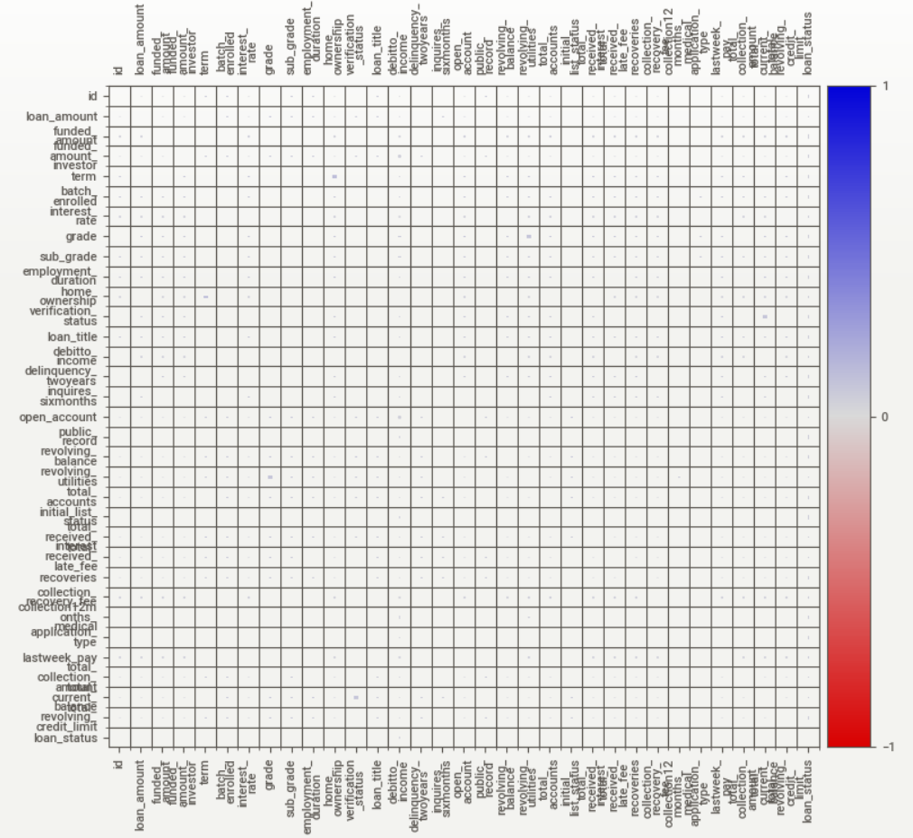

Slide 9
Numerical Features
Boxplots: Yielded no discernible patterns
Histplots: Yielded no discernible patterns
Scatterplots: Yielded no discernible patterns
We’re going to have to engineer some features

Slide 10
Categorical Features
Checking number of defaults as a percentage of the total number of those feature value observations.
Yielded some more obvious patterns than the continuous features did by looking at the difference in percentages, although they were generally normally distributed across most unique values.

Slide 11
Feature Engineering
loan_title: reduced number of unique values from 109 to 17 by broadly categorizing them
batch_enrolled: 41 batches reduced to 3 groups
grade: 7 grades to 3 groups
sub_grade: 35 sub grades to 4 groups
Added arithmetic features

Slide 12
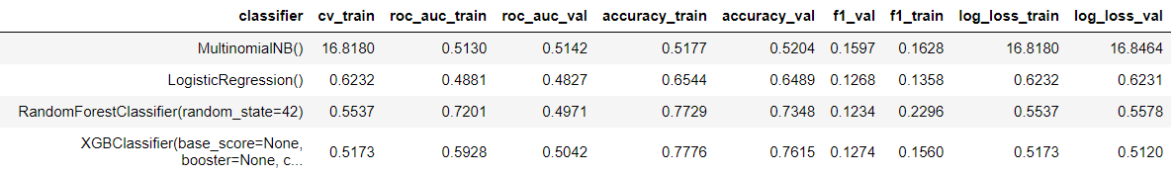
Modelling
Also ran a LightGBM model but it took 5 hours to run and the results were similar to XGBoost.

Slide 13
Feature Engineering
Converted all continuous features into categorical ones by binning each feature into 4 ranges of values before modelling again.
Used the top 25 features from the resulting to try modelling again for a better score.

Slide 14
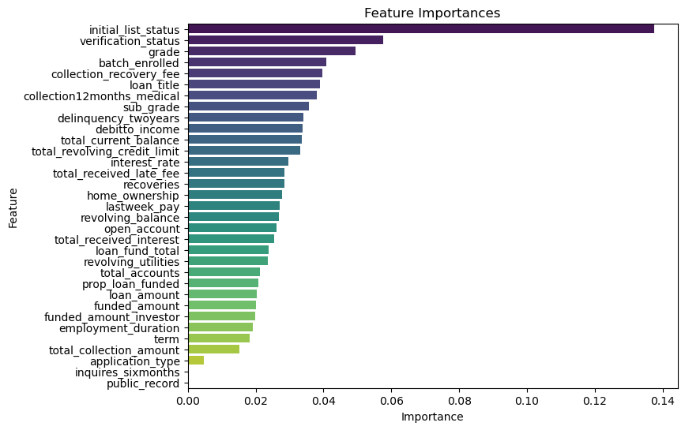
Feature Engineering

Slide 15
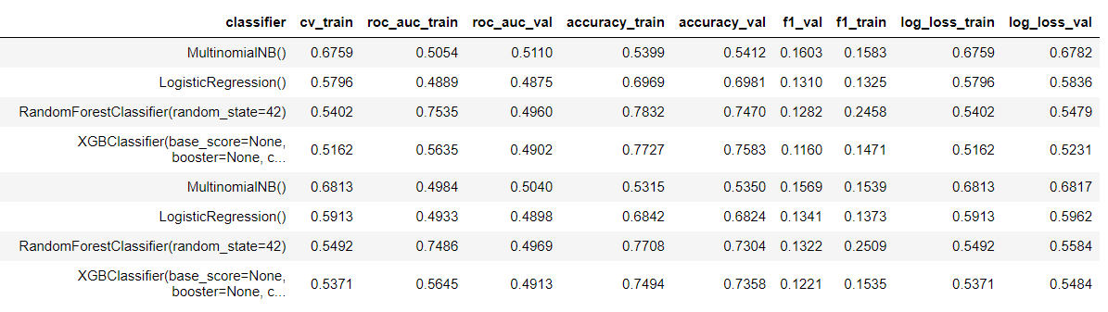
Modelling

Slide 16

Final scores on test data with best model

Slide 17
Conclusion
Just as a benchmark, the Log Loss score for the top performer in this competition was between 0.34 to 0.35.
The process of feature engineering when dealing with a dataset like this is important in getting better scores.
Binning features and making them categorical seems to work especially well with Random Forest Classifier and XGBoost.

Slide 18
Recommendations
The model is not yet the finished product to be deployed, but can be used as a base to continue improving.
Feature engineering based on the feature importance from the best model will play a big role in the next steps in the next phase of the project which I will continue to work on over the next few weeks.
Obtaining the right data from customers to be used as features in the model besides what was provided might prove more useful than tweaking existing data.
In order to get the model good enough to deploy, a few things need to be accomplished.
Feature engineering and continued tuning to get better Accuracy and F1 scores
Reduction of features such that the deployment feature ranges are easily obtainable by bank clients and the bank.
Model needs to run fast in order to be deployed for customer use.

Slide 19
Questions?

Slide 20
To Be Continued…

